Slide 1
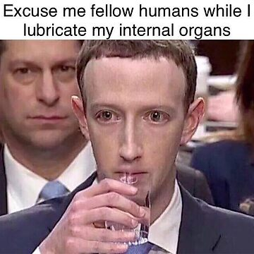
Cambridge Analytica and Facebook Data Scandal
Group 8
Notes:
Good afternoon, ladies and gentlemen.
We are Group 8, my name is Rami, and this is Alex and Tom.
Our presentation today is about the Cambridge Analytica and Facebook Data Scandal.
This widely-publicized case had global attention, through both immense TV coverage and the proliferation of Mark Zuckerberg-related memes during the trial that followed.
Recognized as one of the most significant data scandals of the 21st century, it is very likely to leave a lasting imprint on the data scene for the foreseeable future.
We will delve into the various technical, ethical and legal issues stemming from this incident during our presentation.

Slide 2
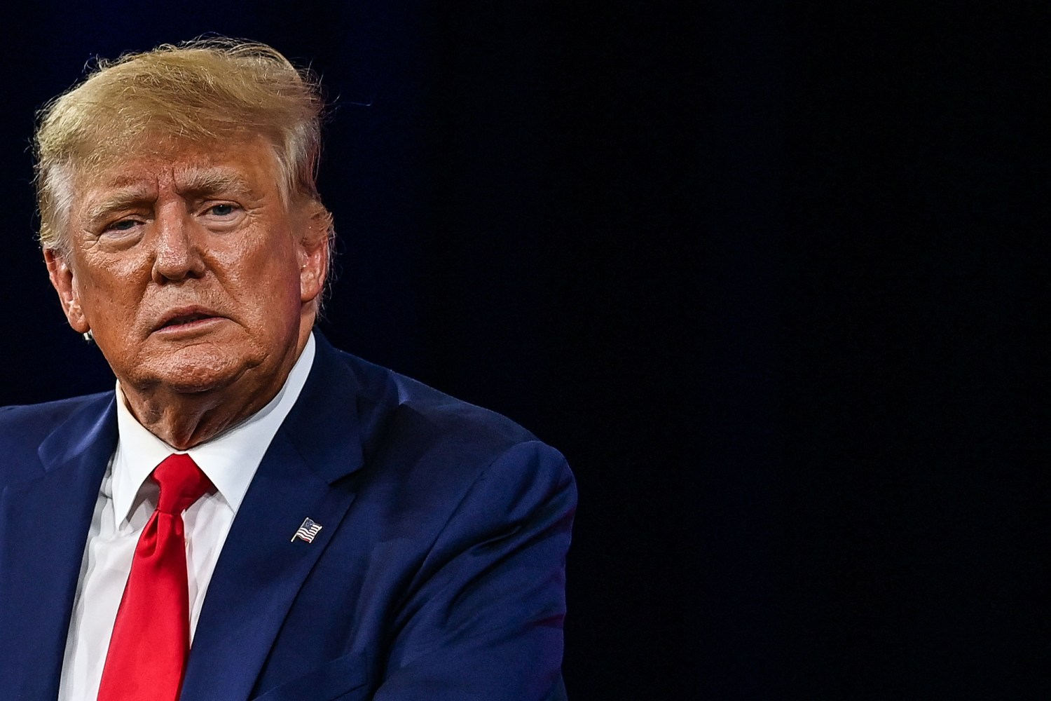
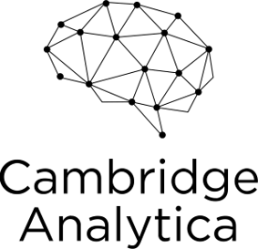
Introduction
What did they do?
Cambridge Analytica was a British political consulting firm based in the United Kingdom.
Self described as a “global election management agency”
Introduction | Technical | Ethics | Legal | Conclusion
Notes:
Firstly, what is Cambridge Analytica and what did they do?
Cambridge Analytica was a political consulting firm based in the United Kingdom. They claimed to specialize in data analysis and psychological profiling to influence voter behaviour.
They offered their services to businesses and political parties who wanted to “change audience behaviour”.
They claimed to be able to analyse huge amounts of consumer data and combine that with behavioural science to identify people who organisations can target with marketing material. They collected data from a wide range of sources, including social media platforms such as Facebook.
They aimed to influence political campaigns, including the 2016 U.S. presidential election and the Brexit referendum in the UK, by targeting users with tailored political ads and messages.
The scandal became widely known in March 2018 when whistle blowers, including former Cambridge Analytica employee Christopher Wylie, exposed the misuse of Facebook data. This revelation triggered a global outrage and led to investigations by various authorities.

Slide 3
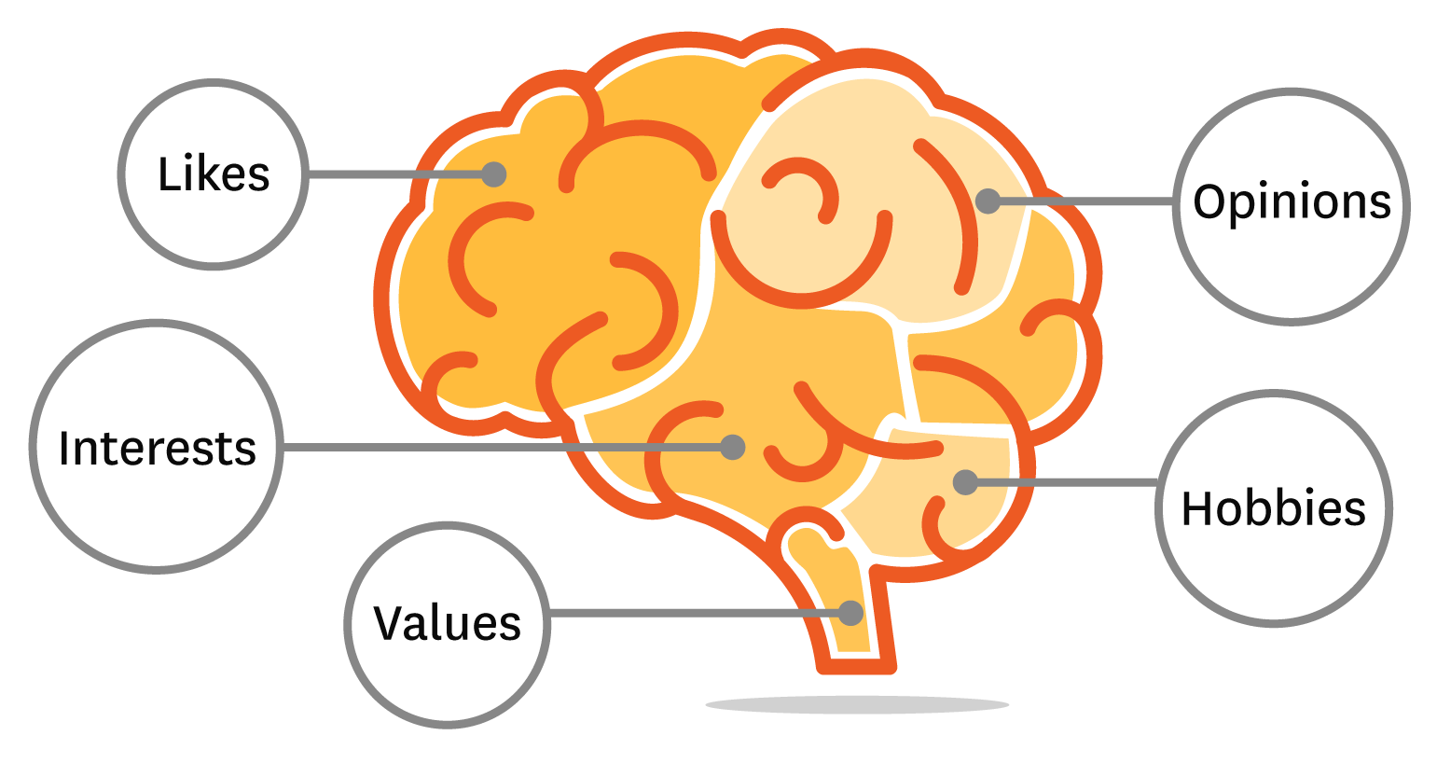


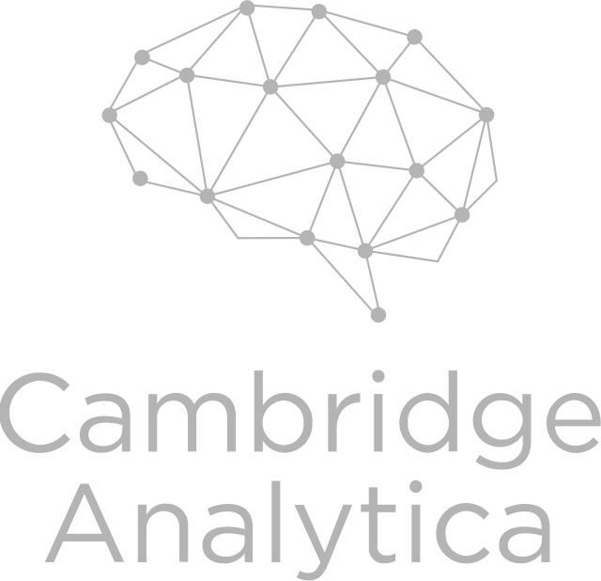
Technical
Overview:
In 2014 CA obtained data from approximately 87 million Facebook users
The data was collected through an app called “thisisyourdigitallife”.
Technical Methods Used:
Data Harvesting: The third party app let users login using their Facebook account and take a personality quiz.
Data Analysis: CA then analysed the data to determine the personalities of American voters. They used “psychographics” to predict personality traits.
Targeted Political Advertising: They combined psychological data with location data to serve targeted political ads based on their psychological profile.
Introduction | Technical | Ethics | Legal | Conclusion
Notes:
In 2014, Cambridge Analytica accessed the personal data of around 87 million Facebook users without their consent, resulting in the largest known data leak in Facebook’s history.
Data Harvesting:
They did this through a third-party app called "This Is Your Digital Life". It was represented as a personality quiz for academic research but was actually collecting vast amounts of data on the users and all their friends.
The third party app let users login using their Facebook account.
At the time, Facebook’s policy allowed the collection of friend’s data to improve user experience in the app, which CA took advantage of.
Users who took a personality quiz on the app unknowingly shared their own and their friends' data.
Data Analysis:
CA then analysed the data to determine the personalities of American voters.
They used “psychographics” to predict personality traits based on their Facebook data.
Targeted Political Advertising:
CA then combined the psychological data with location data to serve targeted political ads.
They micro-targeted users with personalized political messages based on their psychological profile.
They could established what kind of ads get the biggest reaction from certain people.

Slide 4
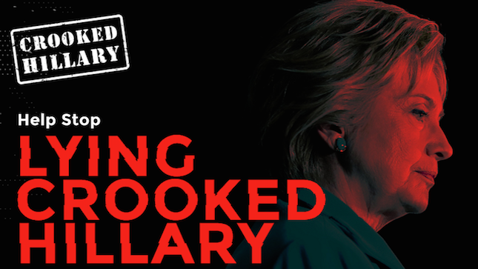

Technical
Machine Learning
Psychological models were mainly based on the OCEAN model
Predict how people would react
Microtargeting
The ads were designed to create fear, anger, spark interest and raise hopes.
Gun Control?
Immigration?
Abortion?
etc
Facebook was the main platform used
Many of the ads were “attack ads” meaning they put the opposition down, rather than promoting their candidate.
Introduction |Technical | Ethics | Legal | Conclusion
Notes:
The raw data was collected and fed into machine learning algorithms to create psychographic profiles of the users.
The psychological models were mainly based on the “Big 5” or OCEAN model.
Openness, conscientiousness, extraversion, agreeableness, and neuroticism
This allowed CA to classify individuals into different psychological categories and predict how they would react to certain types of messaging to be used in micro-targeted advertising.
Many of the ads were “attack ads” meaning they put the opposition down, rather than promoting their candidate, since this invokes the strongest emotions.
Microtargeting is breaking an audience into smaller groups and targeting each group in the most effective way.
The ads were designed to create fear, anger, spark interest and raise hopes.
Examples include Gun Control, Immigration, Abortion, etc.
Facebook was the main platform used since the data was easy to access, the engagements were high, and the ability for information to spread was excellent.

Slide 5





Ethical Concerns
Privacy
Informed Consent
Data Manipulation
Impact on Democracy
Lack of Transparency
Data Ownership
Data Security
Introduction | Technical | Ethics | Legal | Conclusion
Notes:
Ethical Concerns:
The Cambridge Analytica/Facebook data scandal gave rise to numerous ethical concerns concerning data collection and analysis. Among these was the significant breach of privacy. The data access was entirely unauthorized, collected in such a way that even those tangentially connected to someone who had used a third-party app were affected. Users had no knowledge that their data was being utilized by Cambridge Analytica, let alone for what purpose. *CLICK*

Slide 6

Ethical Concerns
Impact on Democracy
BAD
ALSO BAD
Introduction | Technical | Ethics | Legal | Conclusion
Notes:
When examining this from a deontic perspective, the act itself can be deemed ethically wrong, and even from a consequentialist viewpoint, the consequences of the act may be even more concerning than the act itself.
This data was harnessed to manipulate and influence users' political beliefs and behaviour, a matter with profound implications for democracy. The scandal cast a shadow over democratic processes by involving the manipulation of public opinion through precisely targeted political advertising. Ethical questions were raised regarding the impact on democratic institutions and the integrity of the electoral process. For a company to have the power to sway an election in the most powerful country in the world, poses an enormous threat to society. No entity should have that ability, and there must be regulations in place to prevent that from happening ever in the future. There is an ethical obligation to maintain security over our democratic processes.
In reaction the Cambridge Analytica data scandal, Facebook has restricted the access to its API. The outcome of this new policy is that it has now damaged the possibility for independent researchers to study relevant topics in political and social behavior. Yet, much of the public information that the researchers may be interested in is still available on Facebook, and can be still systematically collected through web scraping techniques. Mancosu and Vegetti in 2020 have suggested a the need for a tool for collecting public facebook data without violating the terms of service, as facebooks new restrcitions have forced more people to break policy for their research, as they've deemed consequences do not outweigh the positive outputs.

Slide 7
Ethical Concerns
Privacy
Informed Consent
Data Manipulation
Impact on Democracy
Lack of Transparency
Data Ownership
Data Security
Introduction | Technical | Ethics | Legal | Conclusion
Notes:
The lack of transparency by both Facebook and Cambridge Analytica was another ethical concern related to the case. Both Facebook and Cambridge Analytica failed to provide users with clear and comprehensive information about how their personal data was being utilized. Facebook allowed third-party apps to access user data without adequately disclosing the extent of this access, while Cambridge Analytica was opaque about its intentions and methods for using the data it obtained. In fact Facebook intentionally makes it incredibly difficult to comprehend their terms of use, with the standard terms of use being an over 5000 word document – that links to several other terms and policies including a separate privacy policy, which is over 19000 words long. This lack of transparency raised questions about corporate responsibility in data management. Users expect that their data will be handled responsibly and with transparency, and the scandal underscored the need for more robust ethical standards and oversight in the tech industry to protect user privacy and data rights.
The concept of data ownership was another concept that was highlighted by this scandal. Users of social media platforms like Facebook may have had a reasonable expectation of retaining greater control and ownership over their personal data. However, the scandal revealed that this assumption was often misplaced. Users typically provide their data in good faith, trusting that the platforms will handle it responsibly and transparently. In the wake of the scandal, ethical questions surfaced about who should have the ultimate ownership and control over this sensitive information. It prompted a broader conversation about the rights and responsibilities of users, corporations, and regulatory bodies in the digital landscape.
In addition to data ownership, Data Security also emerged as a moral responsibility that was conspicuously neglected. The scandal exposed serious deficiencies in safeguarding user data. Ethical concerns regarding data security are rooted in the idea that individuals have a fundamental right to privacy and data protection. Inadequate security measures not only undermine this right but can also lead to significant harm. Whether it's identity theft, fraud, or unauthorized access to personal information, failures in data security have tangible and harmful consequences for individuals. As such, the scandal served as a stark reminder of the urgent need for robust data protection measures and emphasized the ethical imperative of safeguarding user data against potential breaches.

Slide 8
Legal Punishments for Facebook
USA
United States of America (FTC) v Facebook, Inc. (2019)
The Case: Facebook violated a previous FTC order and the FTC act.
Removed disclosures to inform users about data sharing with third parties.
Misled users by saying it would stop allowing third-parties access to user’s friends data in 2014 but continued doing it until 2018
The Result: Facebook fined $5 billion and ordered to restructure privacy approach
CEO and other executives exempted from personal liability for violations
Introduction | Technical | Ethics | Legal | Conclusion
Notes:
(8:40) The main legal issue in this scandal was around the violations of privacy that resulted from the data harvesting. Facebook was fined heavily and repeatedly for their role in the scandal, while Cambridge Analytica went bankrupt not long after news of the scandal broke.
In a case brought by the Federal Trade Commission in the US, Facebook was accused of breaching a 2012 settlement and the FTC Act by misrepresenting the sharing of user’s friends’ data. Despite a 2014 promise to stop sharing user’s friends' data, Facebook continued until 2018. As part of the settlement, Facebook faced a record $5 billion fine, the largest global privacy penalty ever and 20 times bigger than the previous largest. Facebook also had to restructure its privacy approach, appointing an independent board, and reducing CEO control. Facebook executives, including the CEO, received immunity from personal liability for the violations.

Slide 9
Legal Punishments for Facebook
USA
SEC v Facebook, Inc .(2019)
The Case: Violated Securities Act (1933) through misrepresentation
Facebook made misleading disclosures to shareholders about the risk of misuse of user data by third parties.
The Result: Fined $100 million without admitting or denying the SEC’s allegations
Facebook, Inc Consumer Privacy User Profile Litigation - Class Action Suit (2023)
The Case: Facebook granted numerous third parties access to plaintiff’s content without their consent
The Result: Meta paid $725 million to settle while denying all wrongdoing
Introduction | Technical | Ethics | Legal | Conclusion
Notes:
Facebook also settled a lawsuit brought by the SEC that Facebook made misleading disclosures to shareholders about the risk of misuse of user data by third parties. For over two years after knowing a third party developer had misused data, they continued to present the risk as purely hypothetical. Facebook agreed to pay 100 million dollars which will be paid to ‘harmed’ investors without admitting or denying the allegations.
A class action suit brought by Facebook users was settled earlier this year and Facebook agreed to pay 725 million dollars to settle while denying all wrongdoing. Its estimated if every possible plaintiff claimed their share of the settlement, each would get something like $3 each – so hardly a huge payout.

Slide 10
Legal Punishments for Facebook
Violation of Election Law
...there haven't been any.
Introduction | Technical | Ethics | Legal | Conclusion
Notes:
For violating election law in the United States Facebook was… not punished at all. It’s actions of selling data to political consultants to manipulate individuals voting preferences is not in violation of any US election law. Cambridge Analytica acted broadly in line with the law as well, and other advertising companies had been using this type of microtargeting for years before the scandal. If the major ethical concern was about the impact on democracy, then there was a significant lack in corresponding legislation to punish this.

Slide 11
Legal Punishments for Facebook
UK – Information Comissioner's Office
Fined Facebook £500,000 for ‘failing to safeguard people’s information’
Largest possible fine at the time
Australia – Office of the Australian Information Commissioner (OAIC) v Facebook, Inc.
Current case before Federal Court regarding harvesting of 311,000 Australian’s information who did not install TIYDL.
Violation of APP 6 by allowing their data to be harvested and APP 11 by not taking reasonable steps to protect user’s information from unauthorised disclosure
APP 6: Use or Disclosure of Personal Information
APP 11: Security of Personal Information
At Issue in the case: Is Facebook, Inc. an APP entity?
Introduction | Technical | Ethics | Legal | Conclusion
Notes:
In the UK, the Information Commissioner’s office fined Facebook 500 thousand pounds, which was the maximum fine allowed at the time.
In Australia, the Office of the Australian Information Commissioner currently has a case against Facebook in the federal court. Only 53 Australians installed the Daily life app, yet over 311 thousand had their data harvested. Facebook is accused of violating Australian Privacy Principles 6 and 11 for allowing the data to be harvested and not taking reasonable steps to protect user’s information from unauthorised disclosure. If ruled against, Facebook can be fined up to 1.7 million for each violation.
In court, Facebook has tried to claim that it is not an APP entity, by alleging that it doesn’t actually do business in Australia, it essentially just moves cookies around for Facebook Ireland - though the court did reject this claim.

Slide 12
Are the punishments sufficient?
•Facebook has had to payout over $6 billion in fines and payments since 2019.
•Meanwhile, in 2021, it spent over $10 billion on The Metaverse
•Facebook’s annual revenue in 2021 was $118 billion
•Just the price of doing business?
Introduction | Technical | Ethics | Legal | Conclusion
Notes:
Are these punishments for Facebook’s sufficient? Facebook has had to payout over 6 billion in fines since 2019. Meanwhile, in 2021 it had an annual revenue of 118 billion and spent over 10 billion on Zuckerberg’s idea of the Metaverse. Many commentators believe these fines are insufficient and that Facebook might just see them as the price of doing this business.

Slide 13
Facebook's $5b Fine
“This isn’t a fine, it’s a favor to Facebook, a parking ticket which will clear them to conduct more illegal and invasive surveillance,”
- Matt Stoller, Open Markets Institute Fellow
“The settlement imposes no meaningful changes to the company’s structure or financial incentives, nor does it include any restrictions on the company’s mass surveillance or advertising tactics. "
- Rohit Chopra, FTC Commissioner
Introduction | Technical | Ethics | Legal | Conclusion
Notes:
Talking about Facebook’s 5 billion dollar fine from the FTC, Mark Stoller from the Open Markets Institute said “This isn’t a fine – it’s a favour to Facebook, a parking ticket which will clear them to conduct more illegal and invasive surveillance.” Rohit Chopra, one of the FTC commissioners who voted against the settlement and wanted a larger investigation said, “The settlement imposes no meaningful changes to the company’s structure or financial incentives, nor does it include any restrictions on the company’s mass surveillance or advertising tactics.”

Slide 14
What is different under new laws?
EU’s GDPR
Maximum fine in the UK would have been 4% of annual turnover, £315 million instead of £500,000 (630 times larger)
Political micro-targeting a protected type of automated decision-making
Under GDPR Article 22, automated decision-making with significant effects on individuals can only be done in certain situations with stringent requirements.
UK 2018 Data Protection Act
Business that supply data to political parties need to explicitly explain this to users and obtain their consent
USA
5 states have passed comprehensive consumer data protection laws
No federal law passed
Introduction | Technical | Ethics | Legal | Conclusion
Notes:
Under new privacy laws, things might be slightly different but probably not much better. The new GDPR means that the maximum fine allowed in the UK would have been 4% of Facebook’s annual turnover, 315 million pounds instead of 500 thousand. The GDPR also limits the kind of automated decision making which fuelled the micro-targeting by Cambridge Analytica on various platforms.
In the UK, under the 2018 data protection act any business that supplies data to political parties can’t do so without explaining this to the individual and gaining their consent.
In the US, 5 states have passed comprehensive data protection laws with many things in common, including the right to access and delete personal information and the right to opt out of the sale of personal information. No federal law has yet been passed in the US.
If more reforms like these continue to be implemented, it is possible that violations of privacy like this in the future should be less frequent. Though don’t count on it too much, Meta has already got 6 of the 10 largest GDPR fines for varied misconduct in the EU and is still operating strongly.

Slide 15
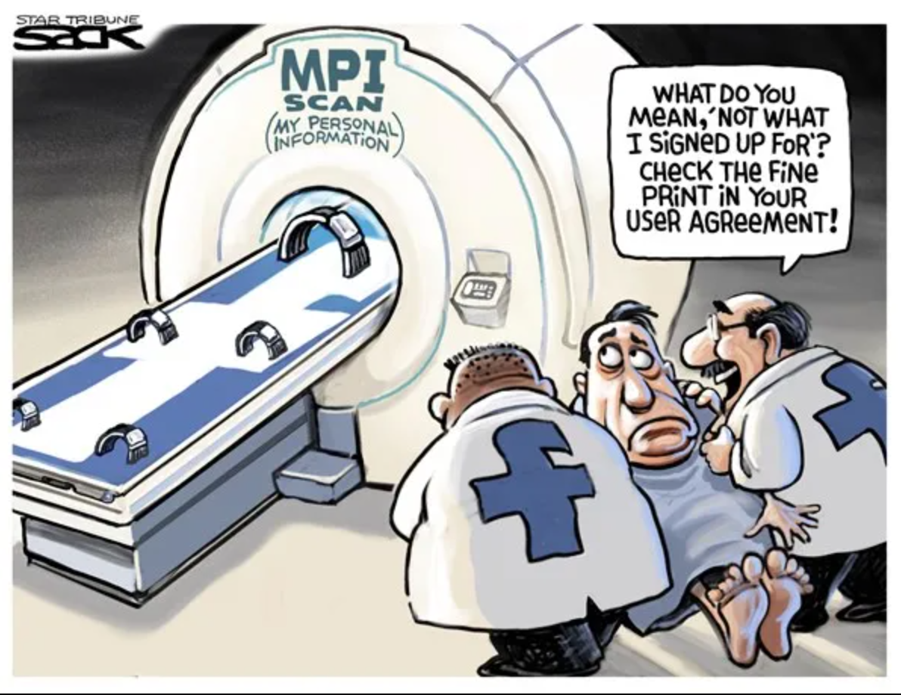
Conclusion
Introduction | Technical | Ethics | Legal | Conclusion
Notes:
To summarise, the Facebook, Cambridge Analytica scandal was likely the largest data scandal of the 21st century so far. Technically, it showed how the breadth and depth of data that social media companies have about us can be used to shape elections. Ethically, it showed that large corporations fail to act in the interests of individuals, and of democracy more broadly. Legally, it shook up the data protection landscape and caused the introduction of more protections for individual’s data. It also showed that there are few legal ramifications for the violation of democracy by big business – and that larger fines are required to significantly deter large corporations with significant revenue streams. Thank you – questions?

Slide 16
Questions?
Introduction | Technical | Ethics | Legal | Conclusion

Slide 17
References
https://www.newscientist.com/article/2166435-how-facebook-let-a-friend-pass-my-data-to-cambridge-analytica/
https://www.nytimes.com/2018/04/04/us/politics/cambridge-analytica-scandal-fallout.html
https://www.bbc.com/news/technology-64075067
Matz, S. C., Appel, R. E., & Kosinski, M. (2020). Privacy in the age of psychological targeting. Current opinion in psychology, 31, 116-121.
Schneble, C. O., Elger, B. S., & Shaw, D. (2018). The Cambridge Analytica affair and Internet‐mediated research. EMBO reports, 19(8), e46579.
https://www.theguardian.com/technology/2019/jul/12/facebook-fine-ftc-privacy-violations
https://www.ftc.gov/system/files/documents/public_statements/1536911/chopra_dissenting_statement_on_facebook_7-24-19.pdf
https://journals.sagepub.com/doi/pdf/10.1177/2056305120940703
Introduction | Ethics | Technical | Legal | Conclusion
Notes:
.alex14

Slide 18
Cambridge Analytica Legal Troubles
USA- broke election law… by allowing foreigners to be involved in management decisions of US political committees.
USA – deceived consumers through data gathering practices… and was ordered to delete any collected data and not make misrepresentations in the future.
UK- broke data law… by not turning over a US professors personal data when ordered to by ICO.
Why so minor? CA filed for bankruptcy shortly after scandal
Introduction | Technical | Ethics | Legal | Conclusion

Slide 19
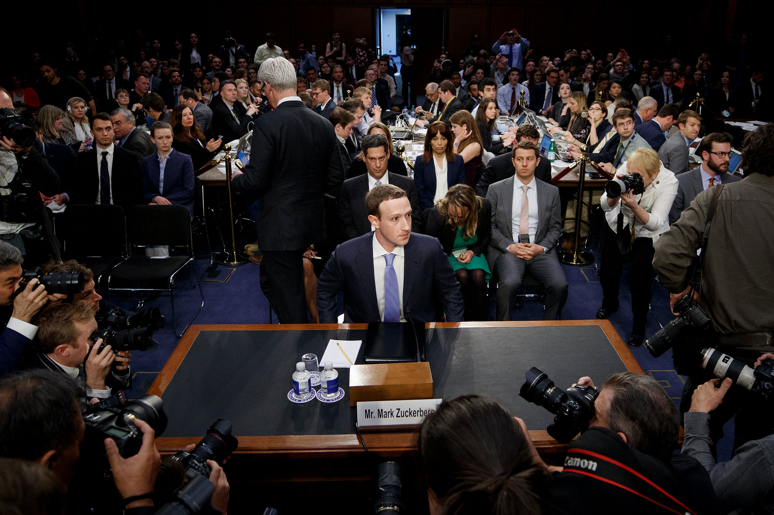
Legal Punishments for Facebook
Zuckerberg grilled by joint Senate Commerce and Judiciary Committees
Introduction | Technical | Ethics | Legal | Conclusion
Notes:
Facebook CEO Mark Zuckerberg was called before the joint Senate Commerce and Judiciary Committees and grilled about Facebook’s involvement in the scandal and approach to privacy more broadly. No laws around data privacy have since been passed by the U.S. Federal Government and there were no repercussions other than Zuckerberg looking uncomfortable and a lot of memes.

